Slide 2
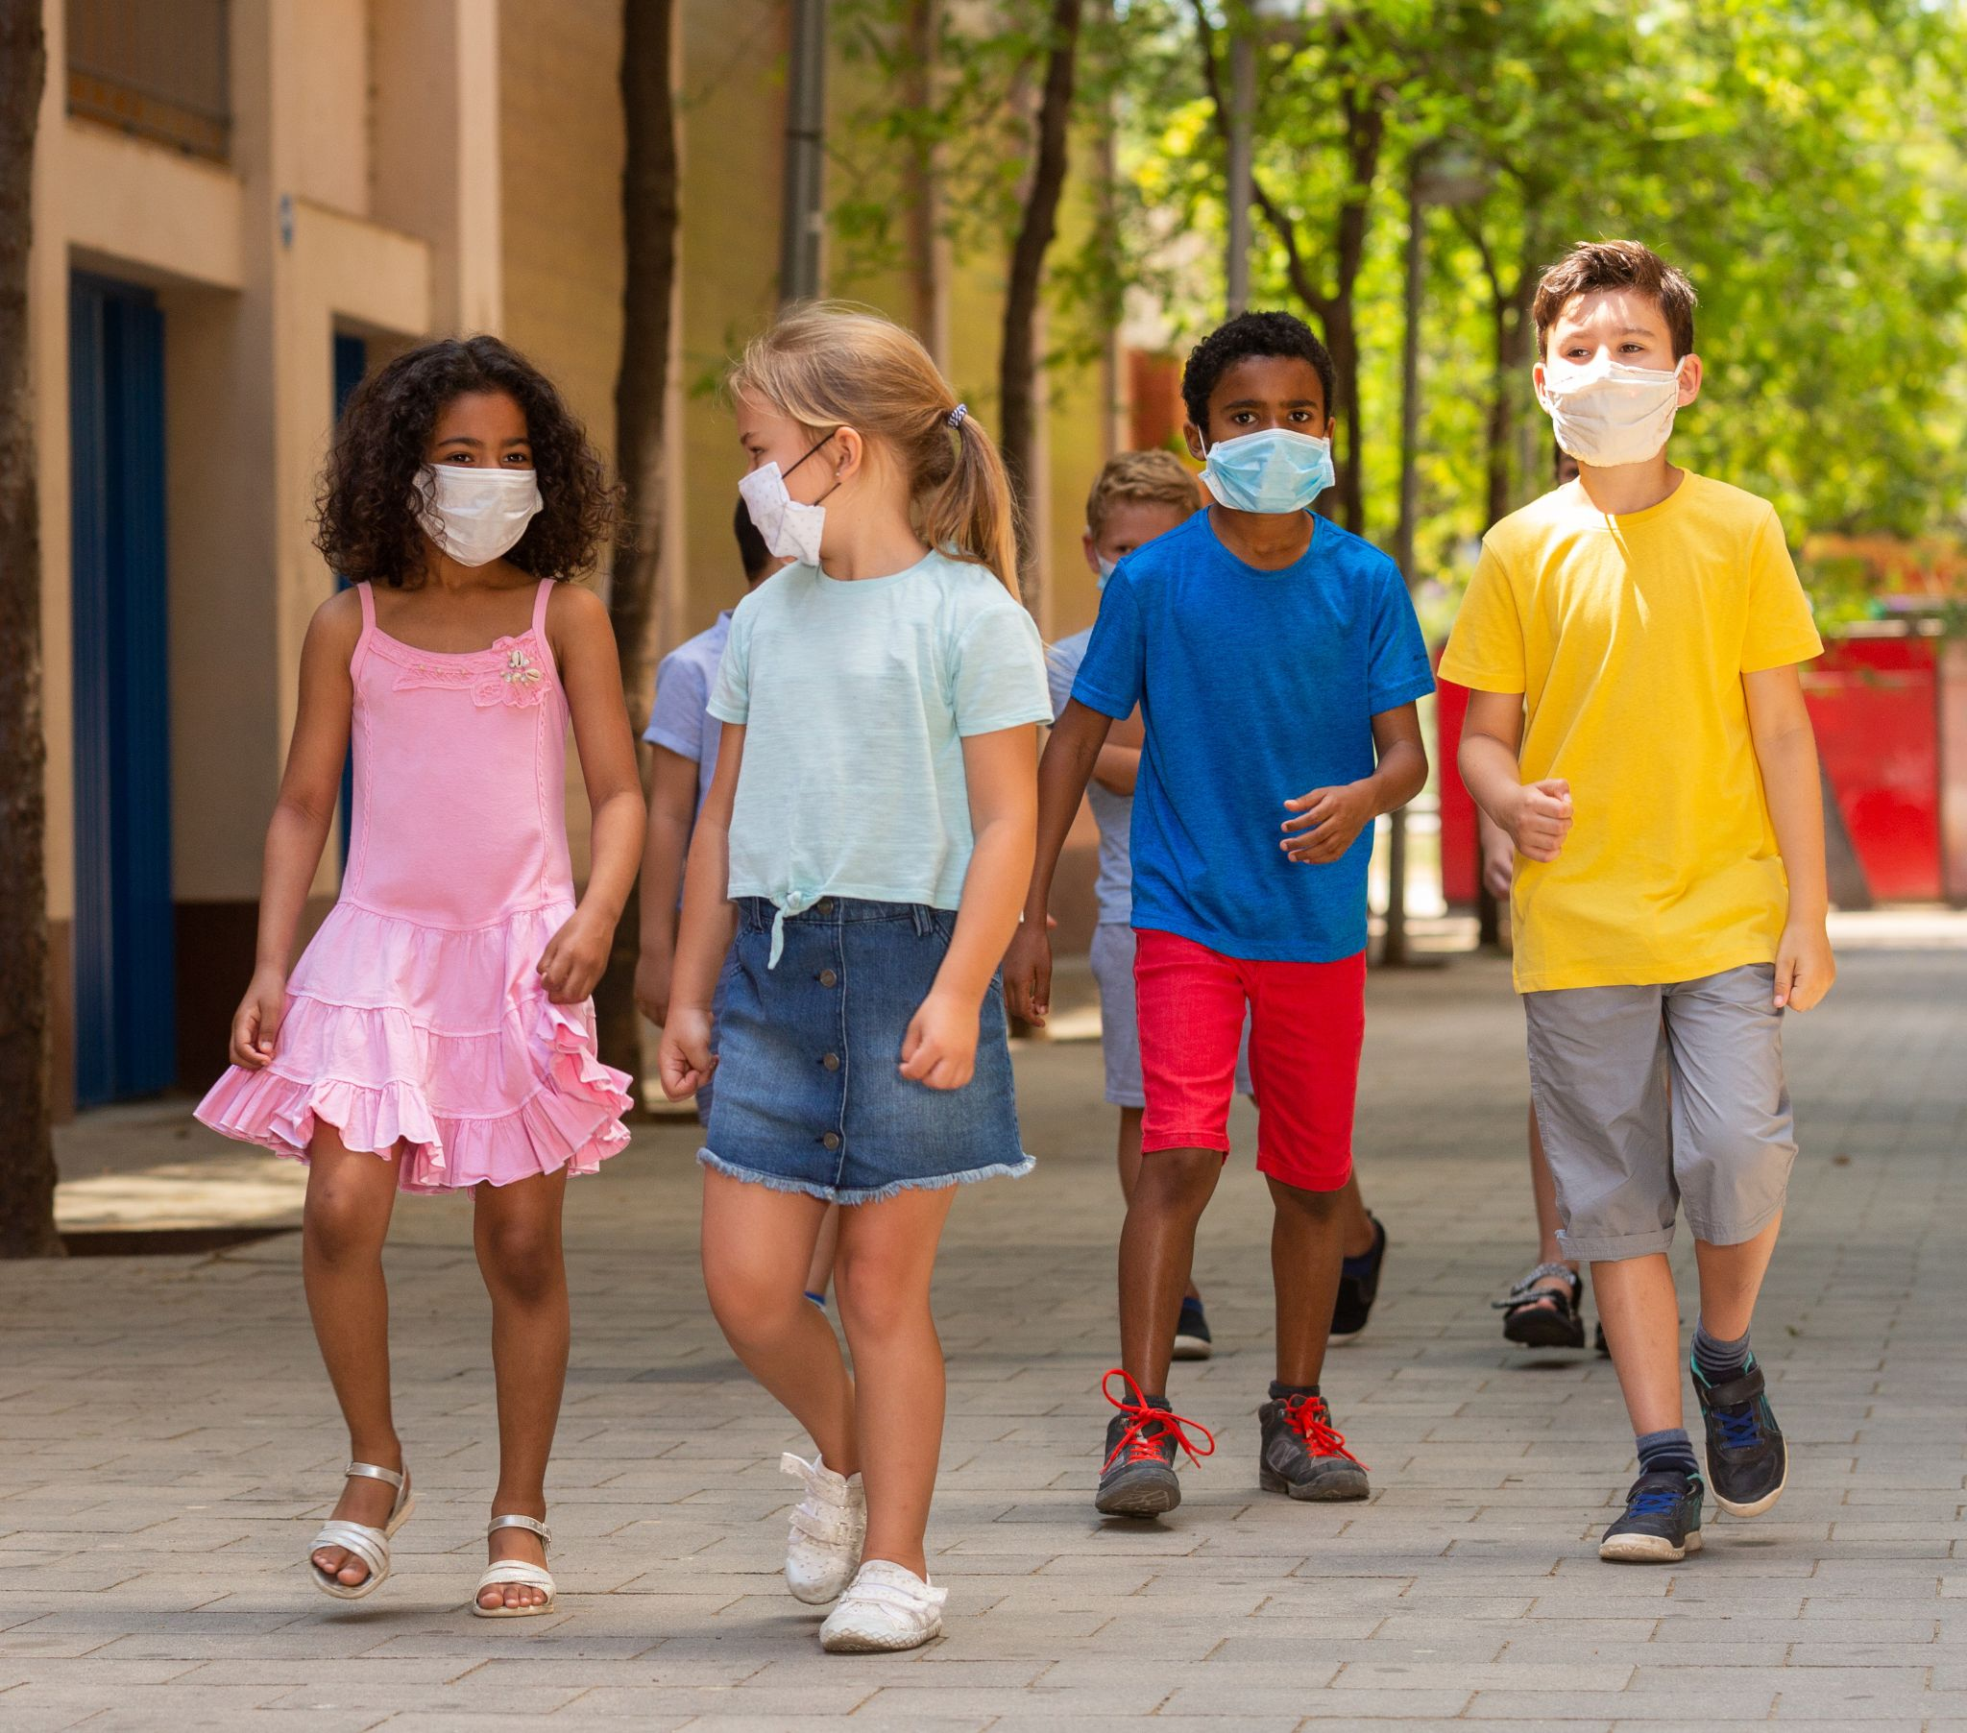
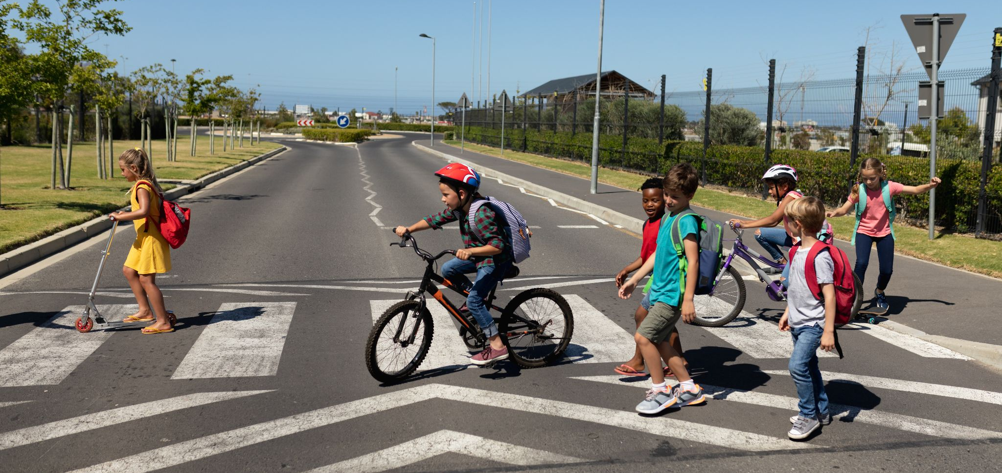
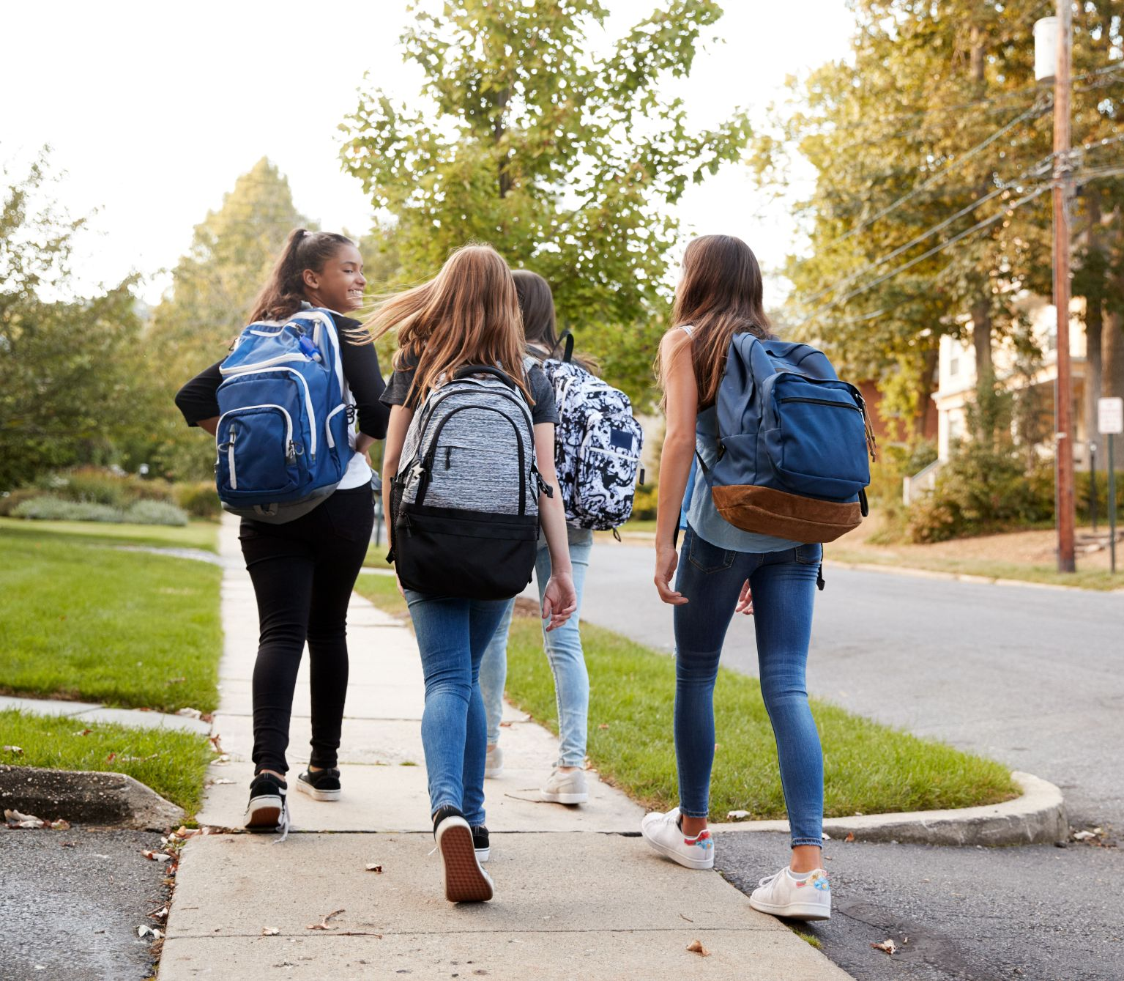
Walking makes us happy, healthy, and focused!
Notes:
Walking is good for our bodies. It keeps us healthy. But it’s also good for our minds! When we stay active, we’re happier and we can concentrate better in school.

Slide 3
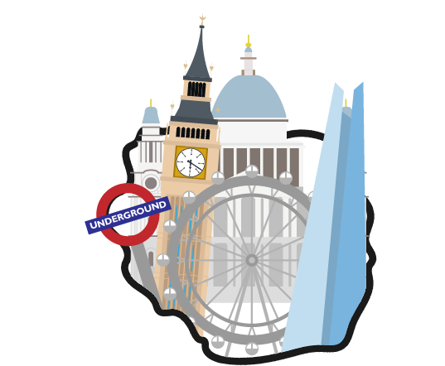
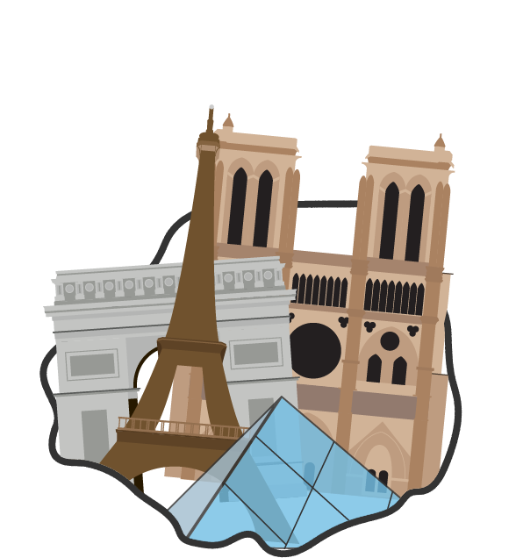
Our Journey: London to Paris
230
miles!

Slide 4
How will we make this journey?
4 laps around the playground = 1 mile
1 mile a week x 23 students = 23 miles a week
23 miles a week x 10 weeks = 230 miles!
[Teachers: adjust this page as needed to reflect the distances your class will travel and details about where you will walk]

Slide 5
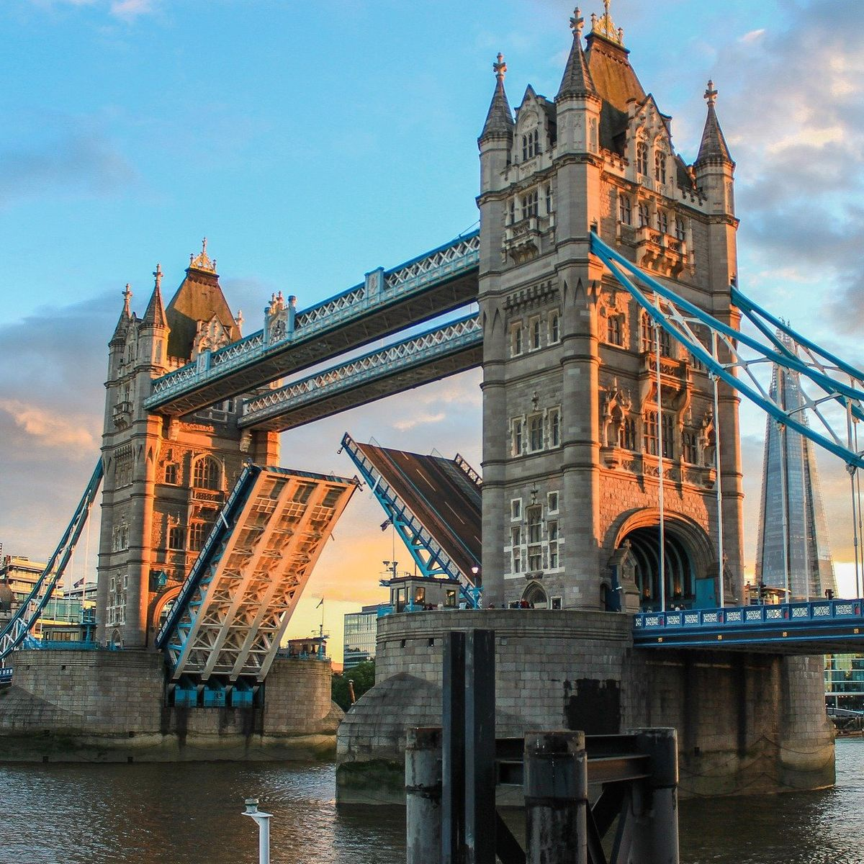
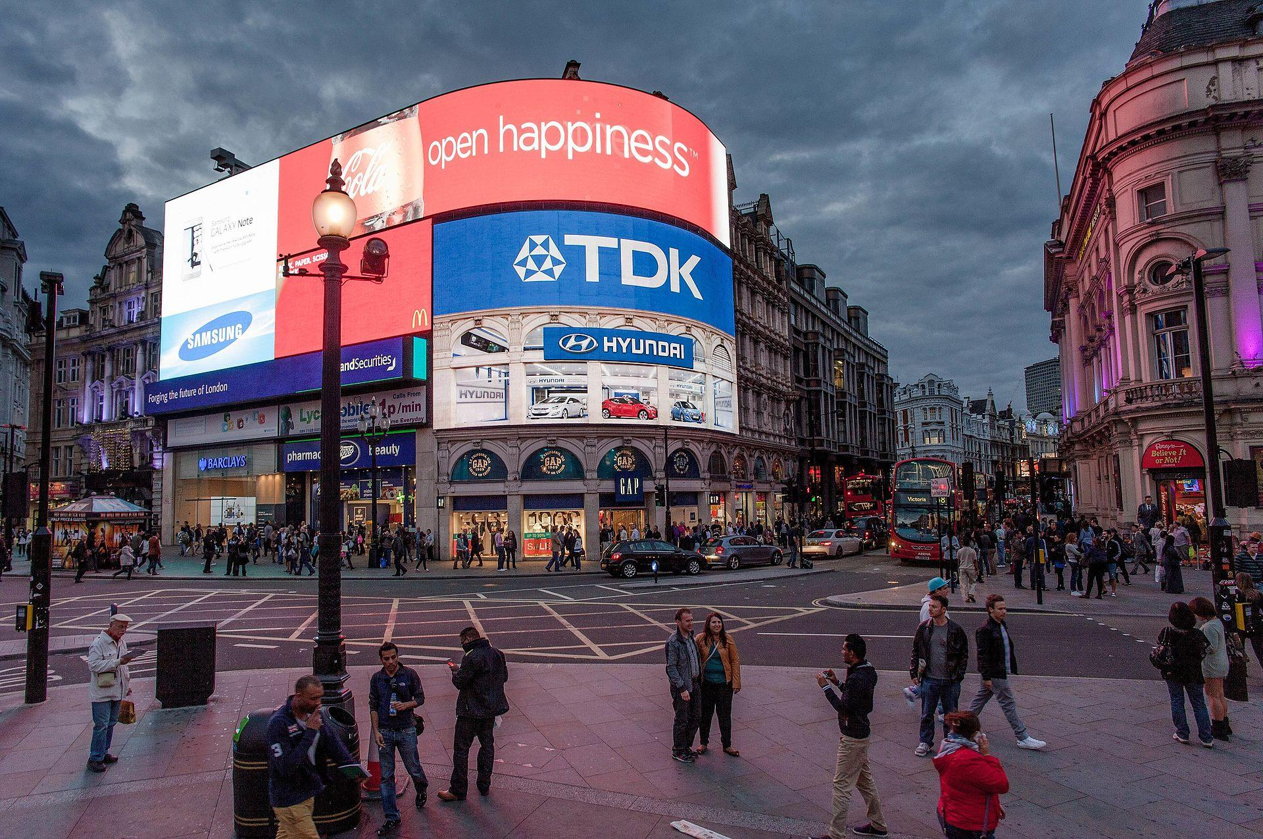
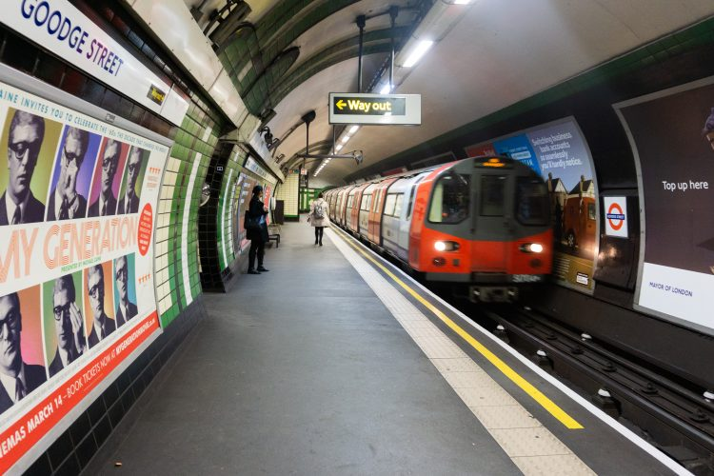
London
Capital of England
3,881 miles from North Carolina
To get to London from North Carolina, you would have to take a 9 hour flight
Primary language is English, but over 300 languages are spoken in London.

Slide 6
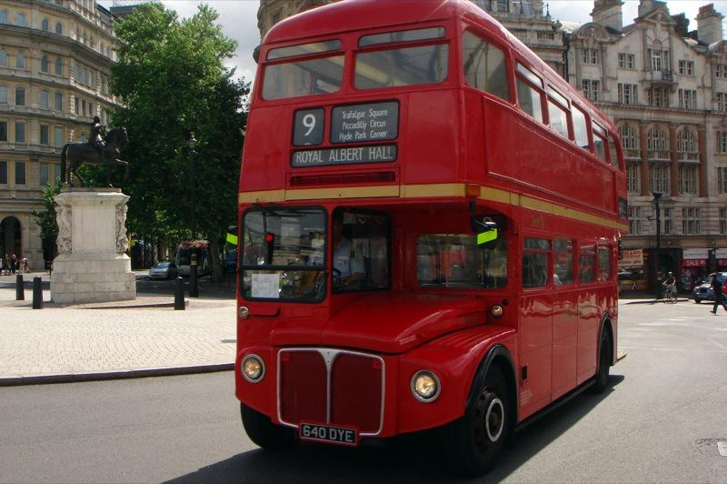
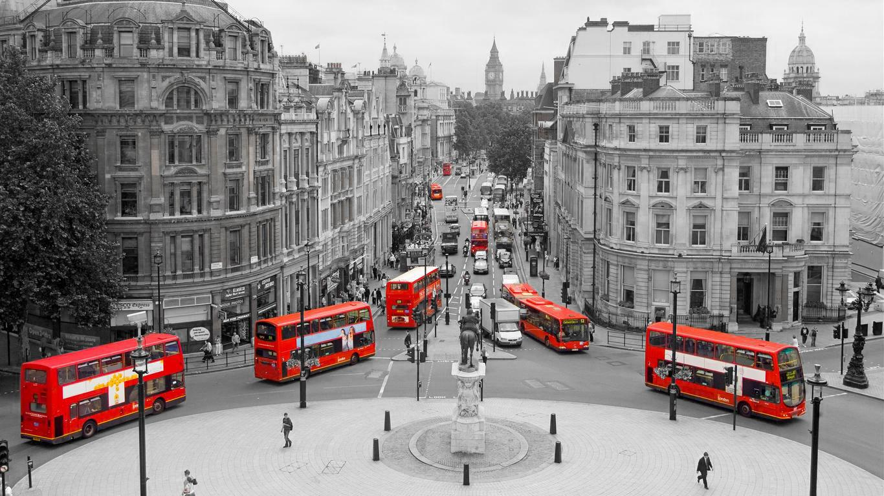
Double-decker buses
London is known for its red double-decker buses
These buses drive over 300 million miles a year - that’s like traveling around the world 12 times every year!
Notes:
Raise your hand if you ride a bus.
This bus looks different, doesn’t it?

Slide 7
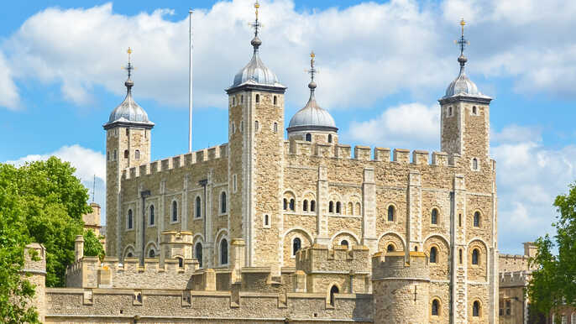
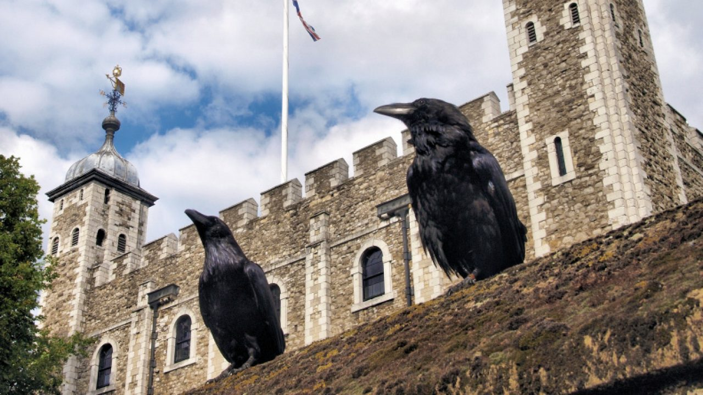
Tower of London
There are always 6 ravens on the grounds at the Tower of London.
They have been there since the 1700s, when King Charles II said that the ravens must be kept there to prevent disaster.

Slide 8
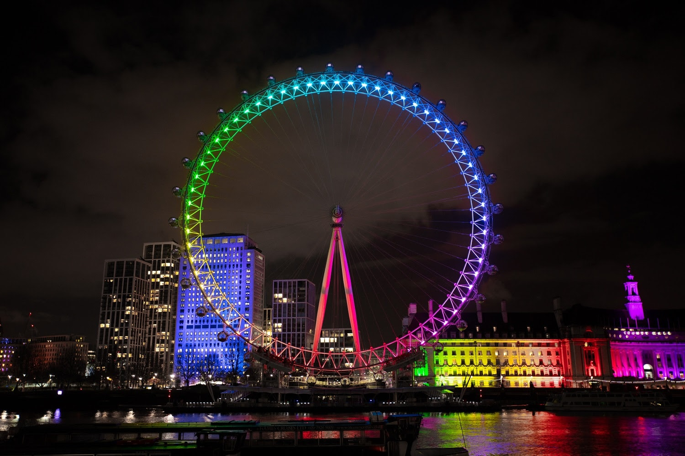
The London Eye
443 feet high - 4th largest ferris wheel in the world!
The Eye is lit up in different colors to mark special dates and events.
Notes:
Raise your hand if you have ever been on a ferris wheel?
Raise your hand if you have seen a ferris wheel? Have you ever seen one this big?

Slide 9
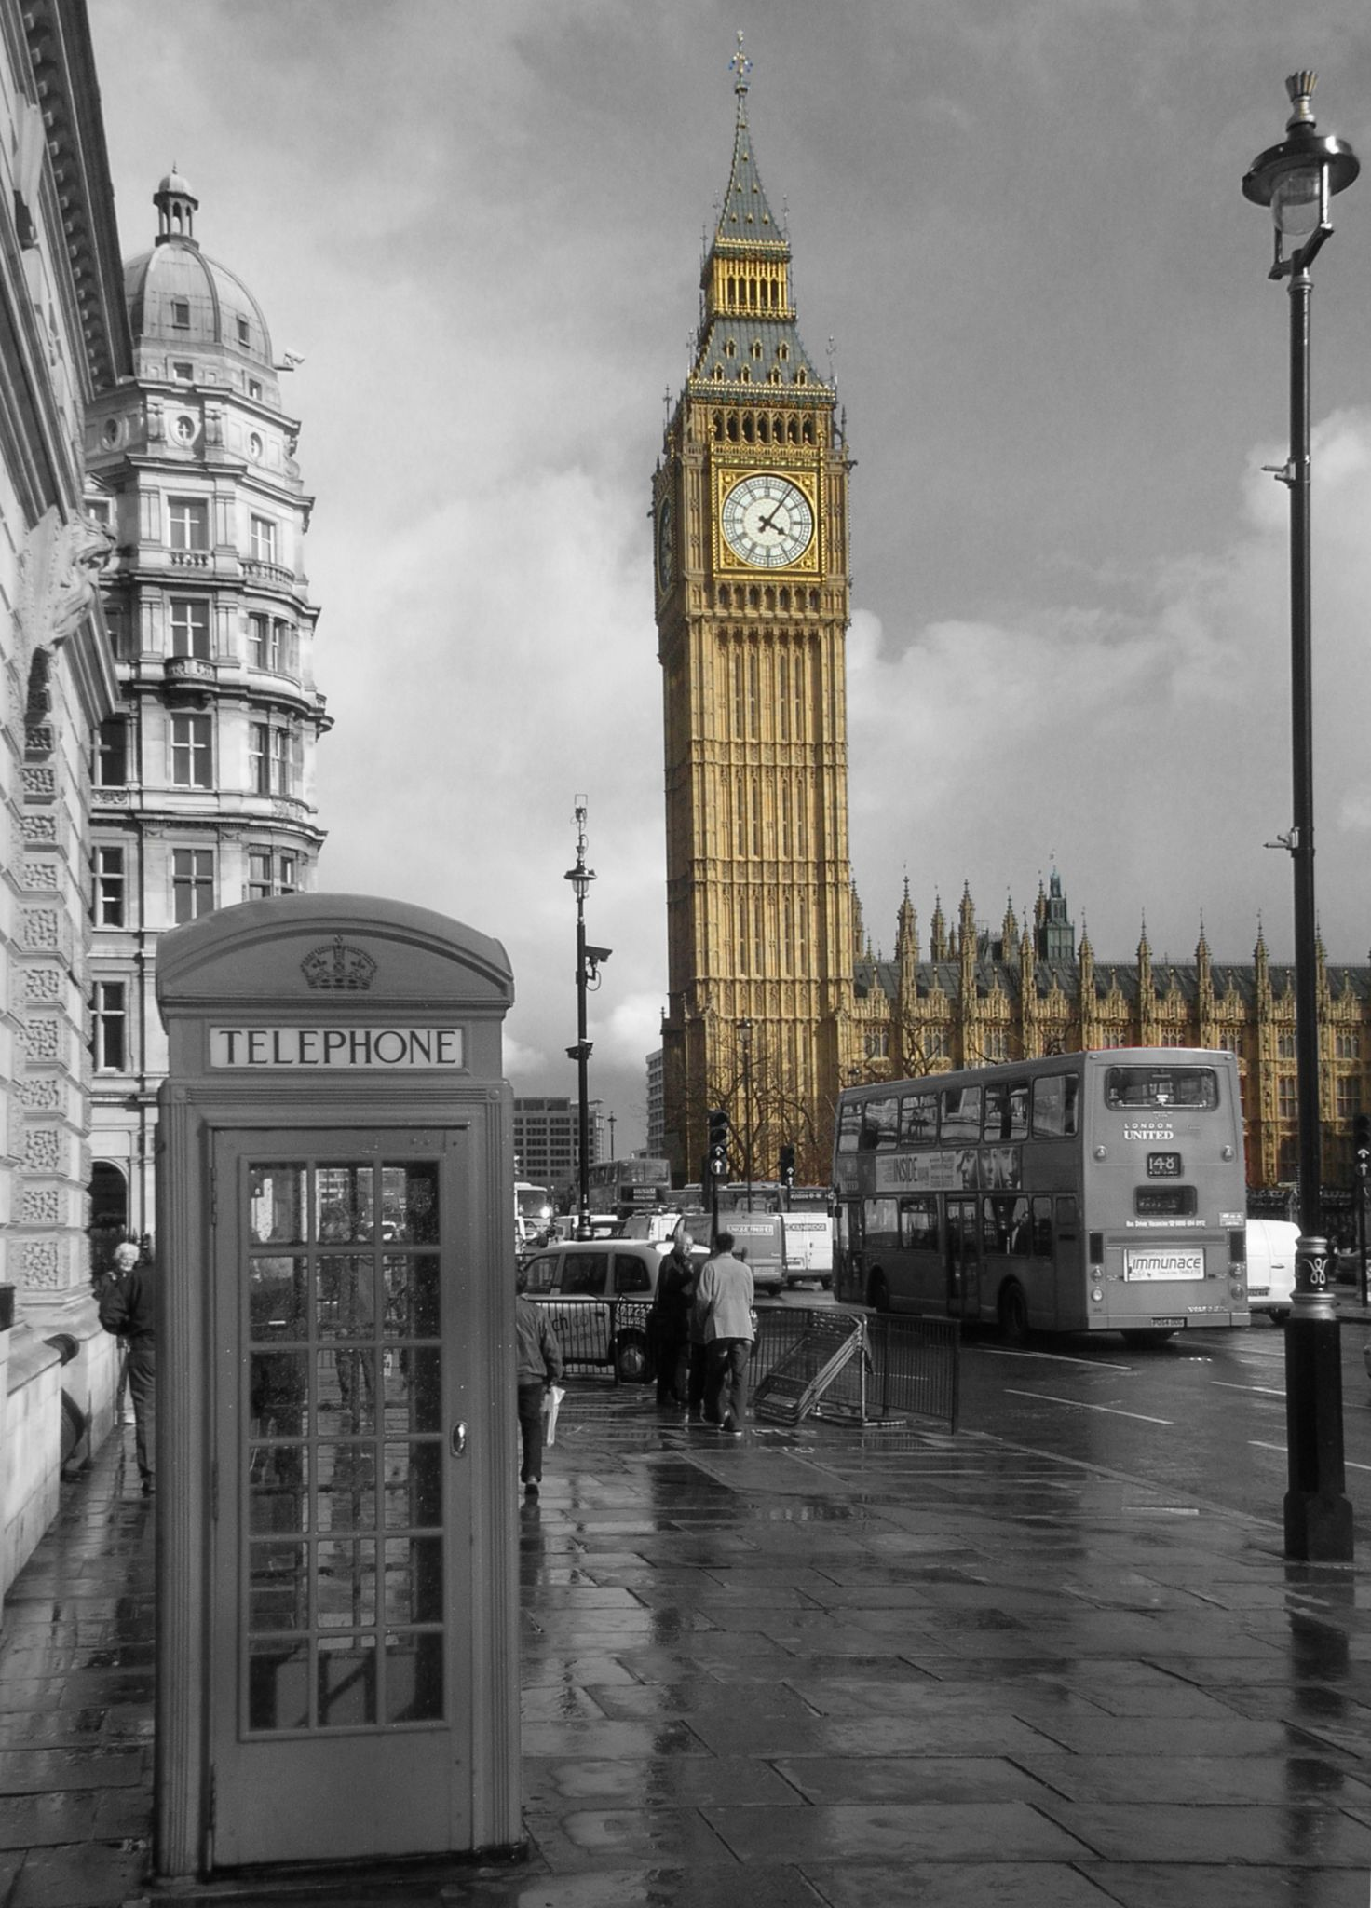
Big Ben
160 years old
A flock of birds rested on the minute hand in 1944. They were heavy enough that they caused the clock to run slow.
Big Ben’s minute hand is 14 feet long

Slide 10
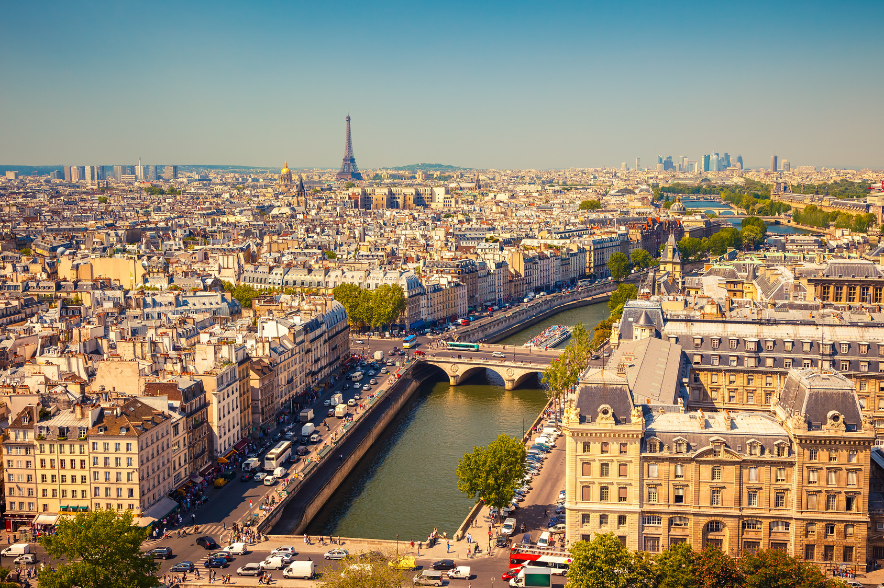
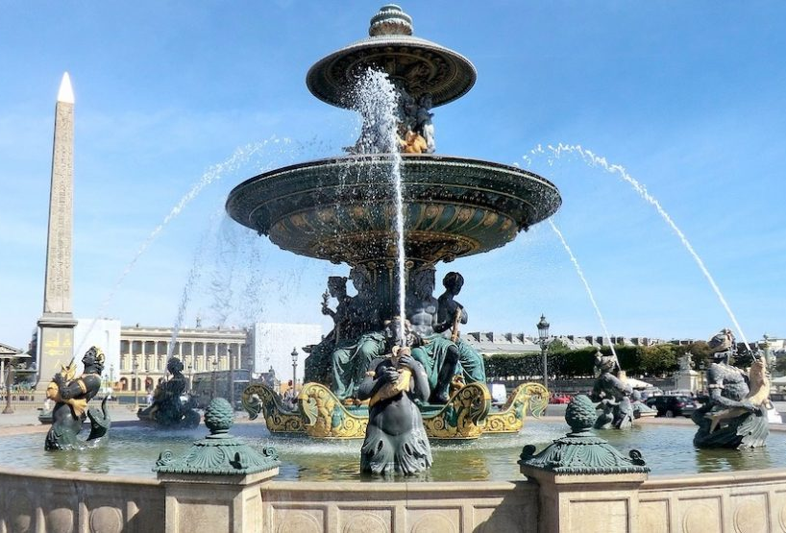
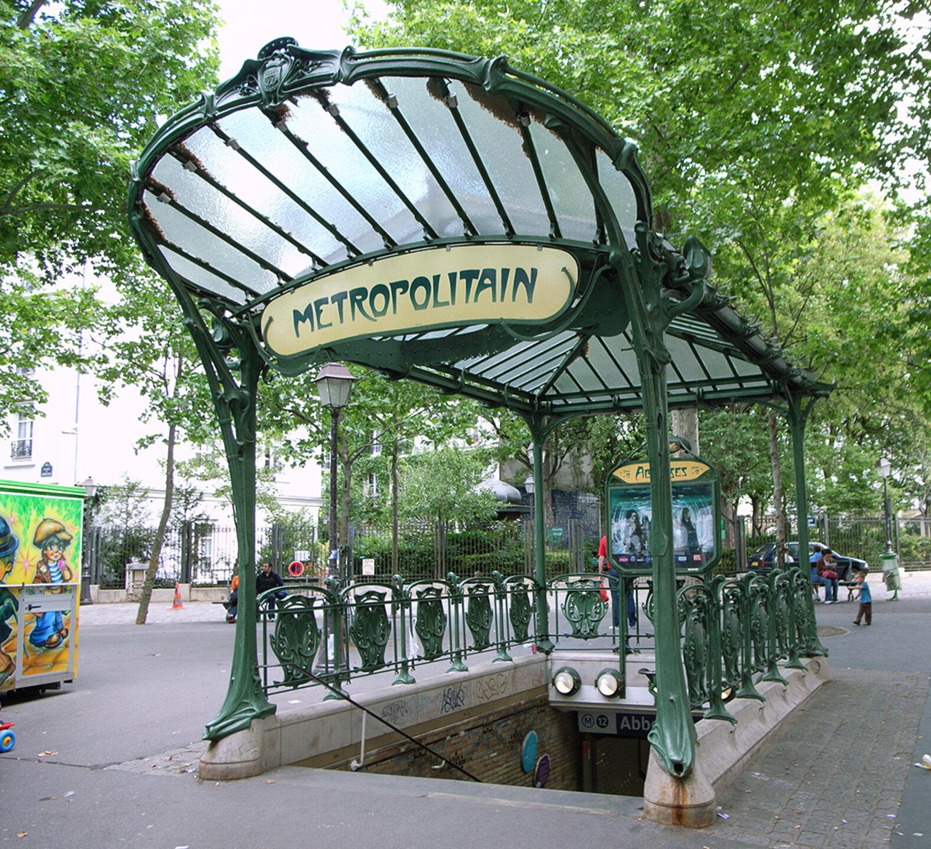
Paris
Capital of France
4,051 miles from North Carolina
To get to Paris, you would have to take a flight over 10 hours long!

Slide 11
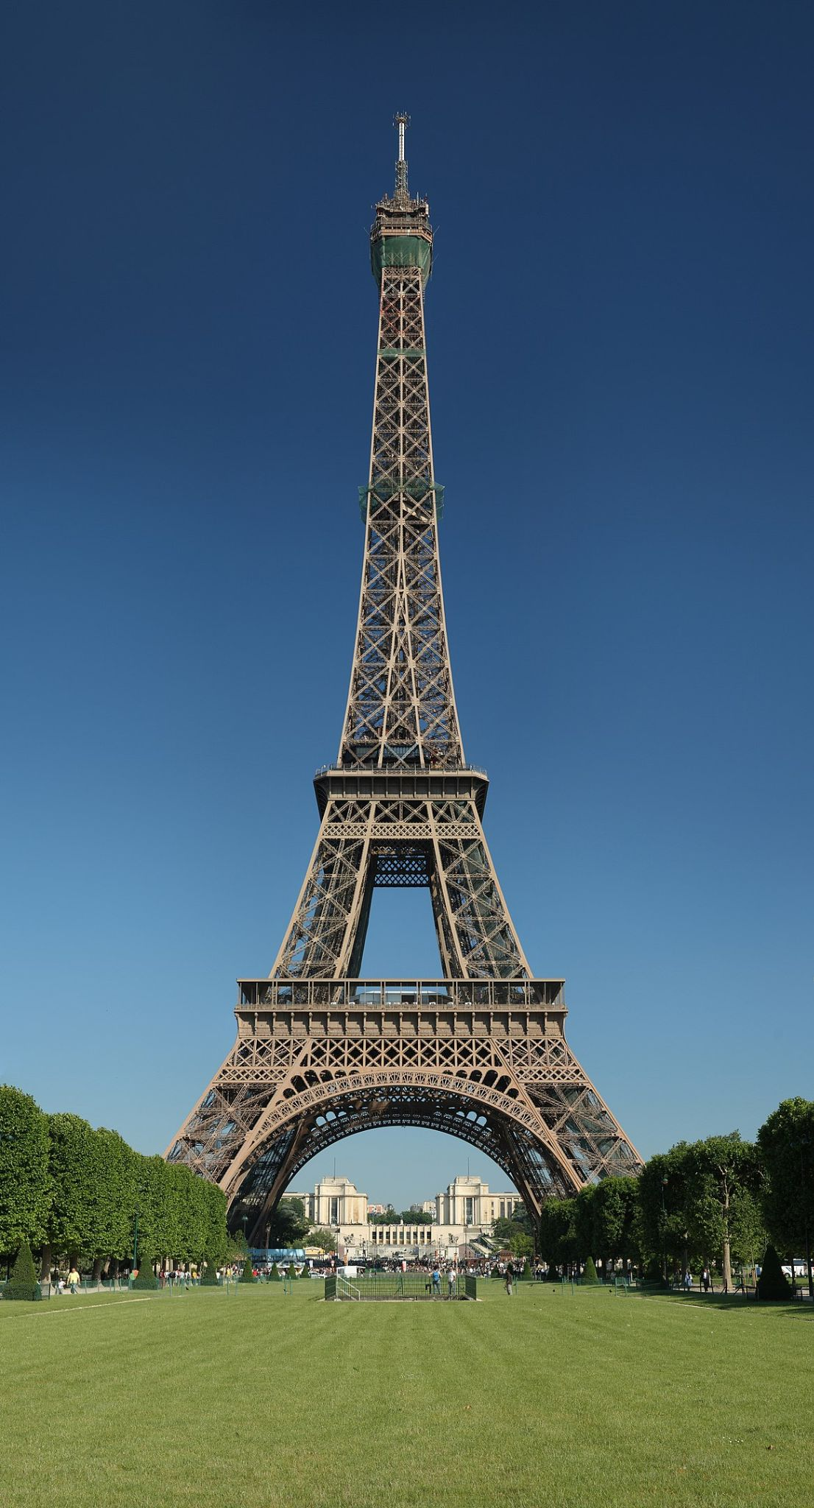
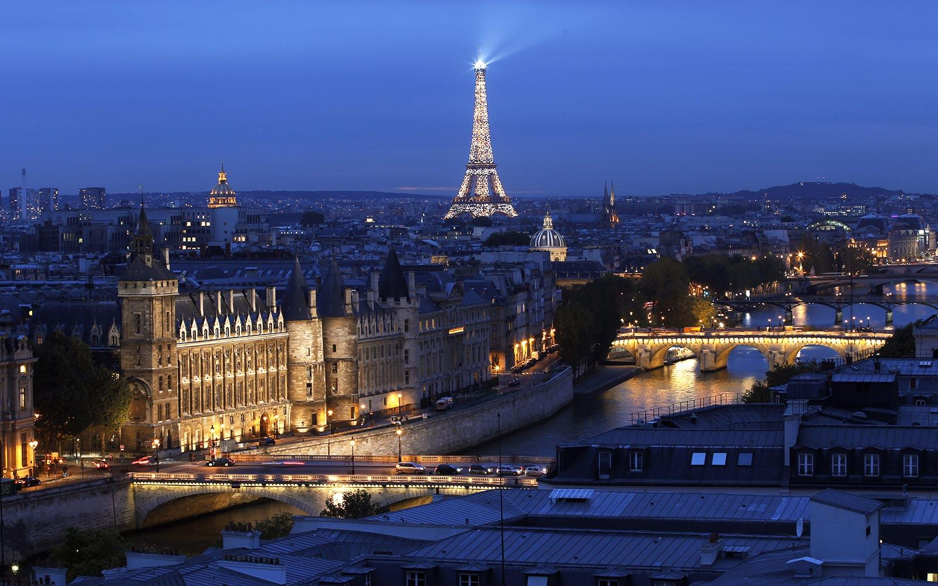
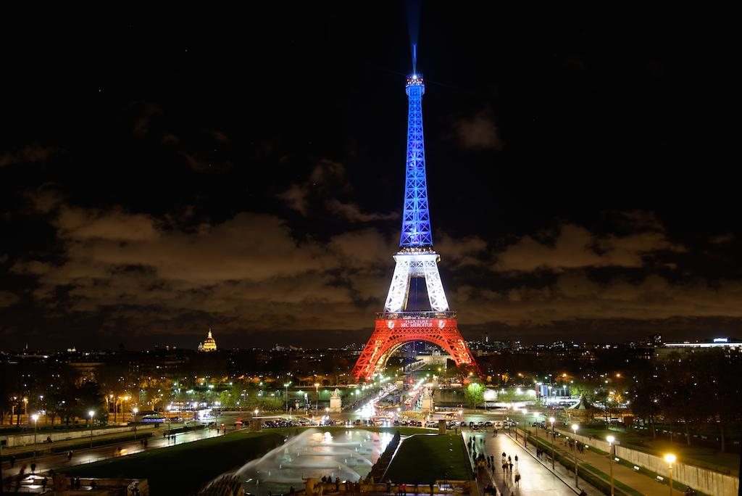
Eiffel Tower
1,063 feet tall
Each night, 20,000 light bulbs light up the tower

Slide 12
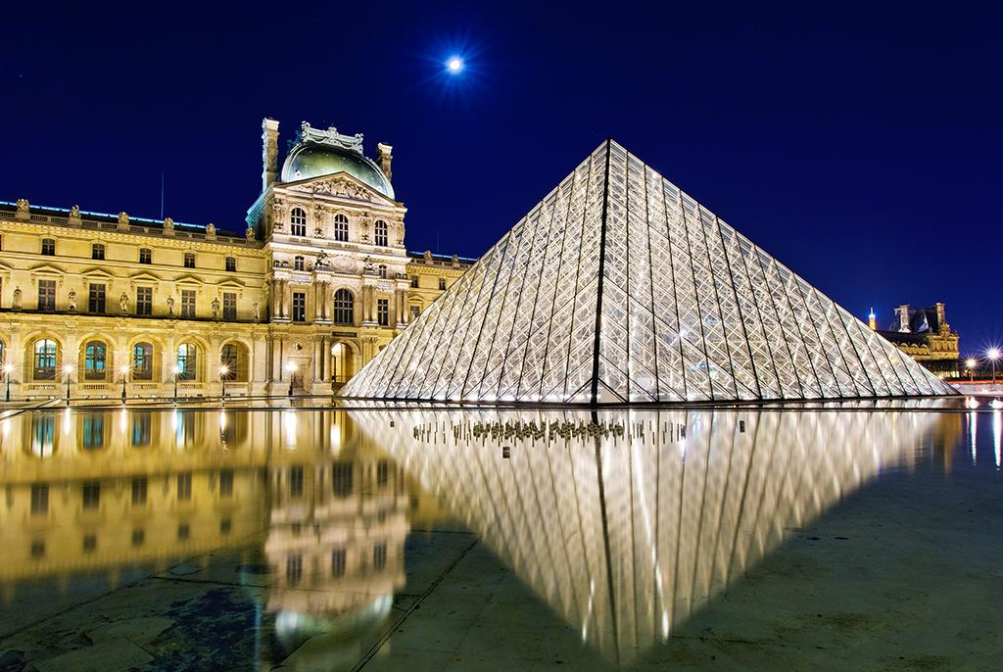
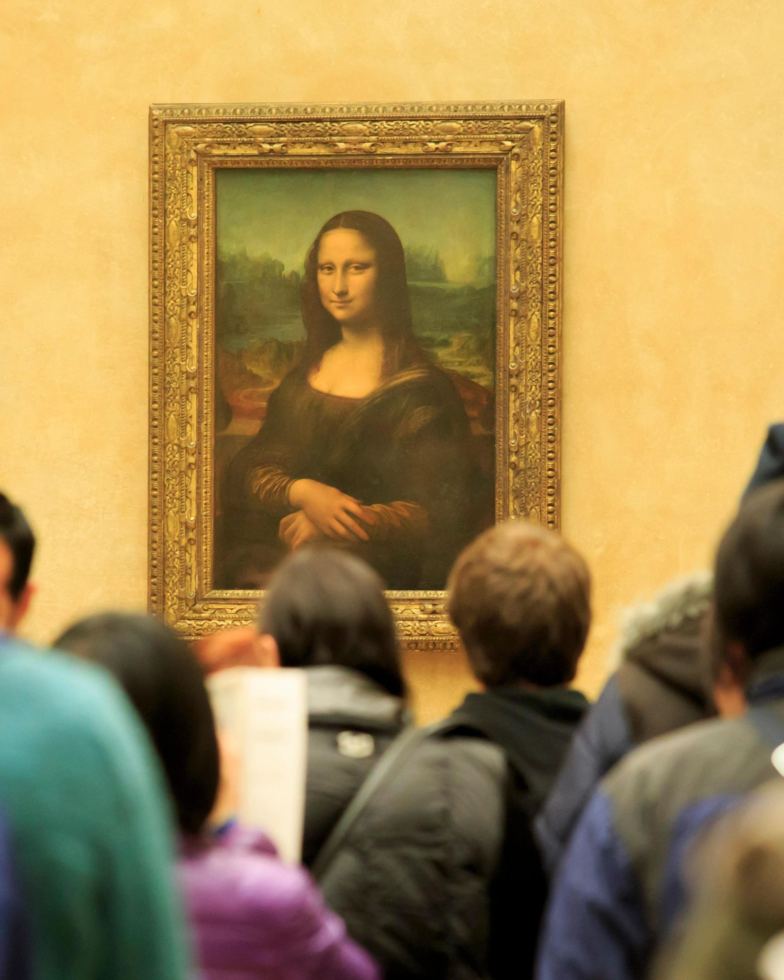
Louvre Museum
Pronounced “loov”
Biggest museum in the world.
Has over 380,000 pieces of art on display - including the Mona Lisa.

Slide 13
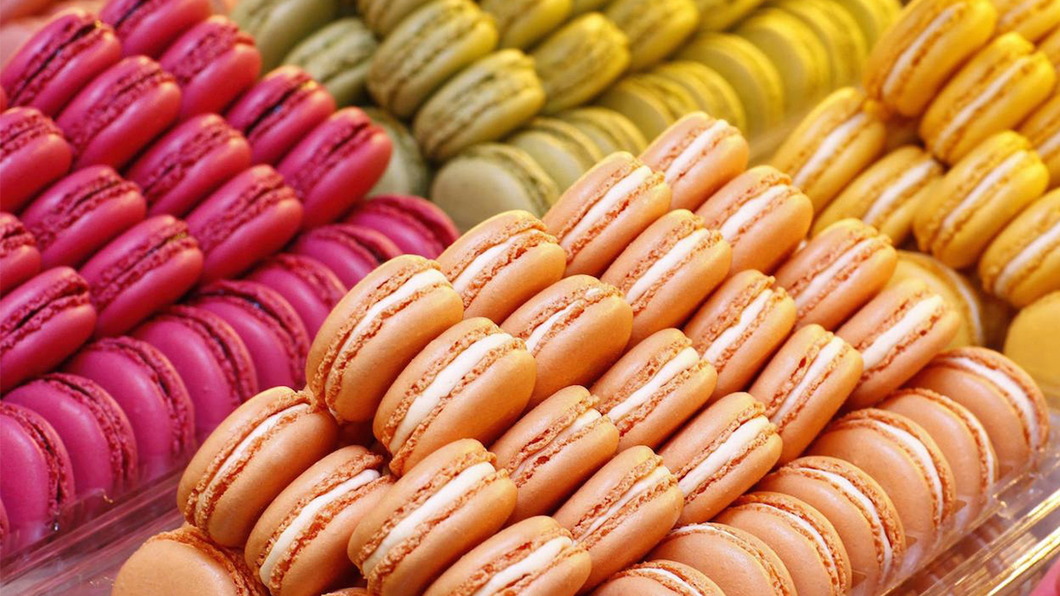
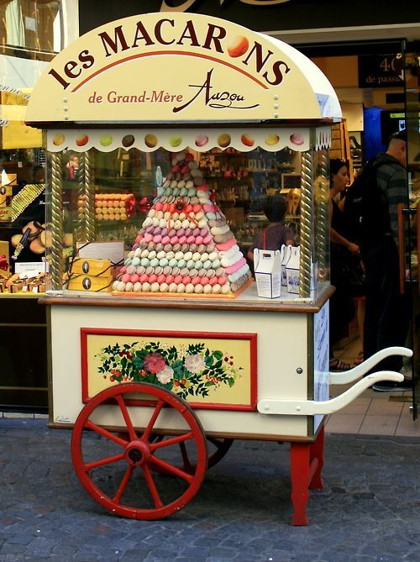
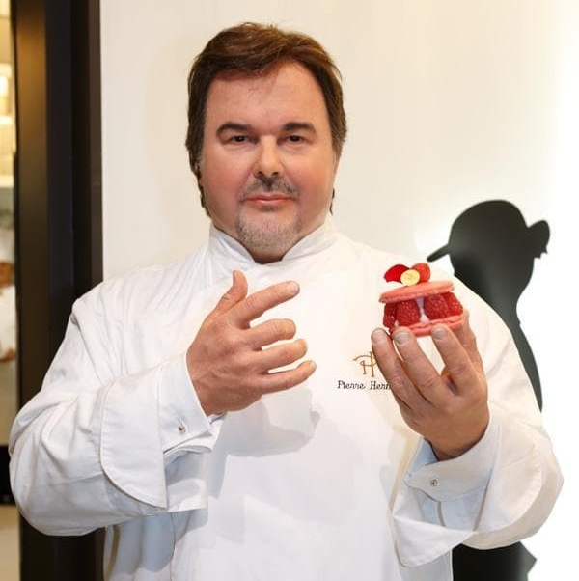
French Macarons
Most popular sweet sold in France.
A Parisian pastry chef, Pierre Hermé, sold the most expensive Macaron in the world for $7,414.

Slide 14
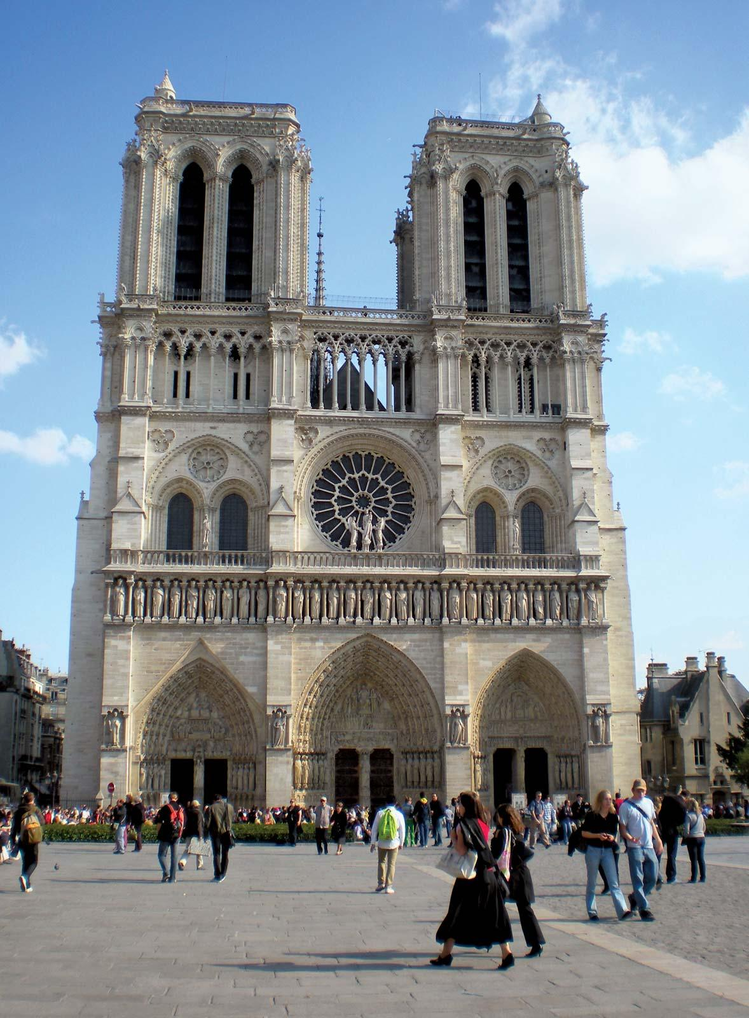
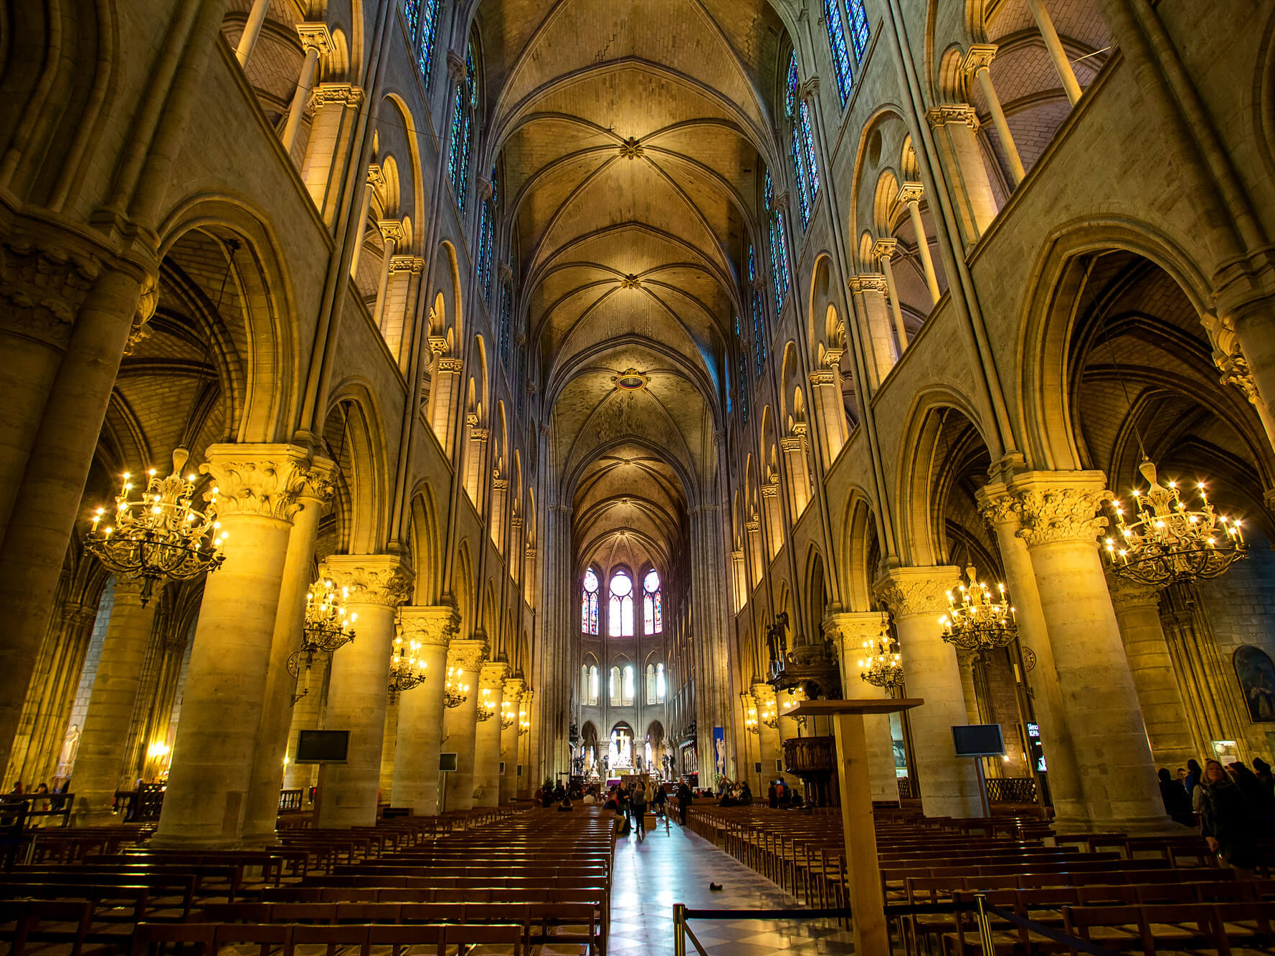
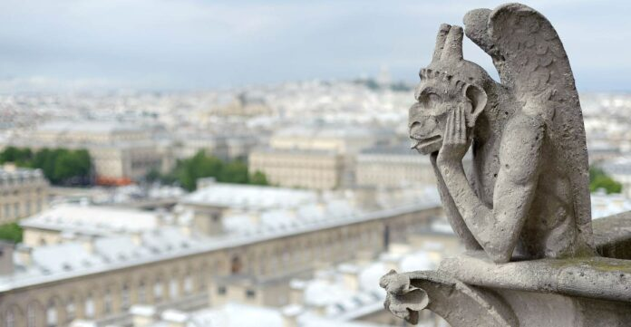
Notre-Dame de Paris
Notre Dame is a very old cathedral in Paris, France.
It is a very good example of Gothic Architecture in France.
You may recognize the cathedral from the Disney movie “The Hunchback of Notre Dame.”

Slide 15
Let’s Go!
Let’s begin our Walk around the World!

Slide 16
Image References
Slide 2
Stock Images Provided by ITRE
Slide 5
Tower Bridge: https://www.mylondon.news/news/zone-1-news/tower-bridge-ban-vehicles-make-20798974
Piccadilly Circus: https://en.wikipedia.org/wiki/Piccadilly_Circus#/media/File:Open_Happiness_Piccadilly_Circus_Blue-Pink_Hour_120917-1126-jikatu.jpg
Tube Station: https://www.intelligenttransport.com/transport-news/126501/northern-line-extension/
Slide 6
Left Bus: https://commons.wikimedia.org/wiki/File:Red_double_decker_bus_in_London.jpg
Right Busses (Edited by ITRE): https://content.r9cdn.net/rimg/dimg/8a/d8/29dcb2f0-city-28501-17579c53c1d.jpg?crop=true&width=2160&height=1215&xhint=1560&yhint=1280&outputtype=webp
Slide 7
Tower of London: https://cdn.getyourguide.com/img/location/5ca348c3482ea.jpeg/88.jpg
Tower Ravens: https://hidden-london.com/nuggets/ravens-of-the-tower/
Slide 8
London Eye: https://secretldn.com/london-eye-new-years-eve/
Slide 9
Big Ben: https://en.wikipedia.org/wiki/Culture_of_London#/media/File:London_Big_Ben_Phone_box.jpg
Side 10
Paris Skyline: https://www.campusfrance.org/en/cities/paris
Obelisk of the Concorde: https://www.unjourdeplusaparis.com/en/paris-reportage/histoire-obelisque-louxor-paris
Paris Metro: https://www.esa.int/ESA_Multimedia/Images/2015/02/Paris_Metro
Slide 11
Eiffel Tower (Day): https://en.wikipedia.org/wiki/Eiffel_Tower#/media/File:Tour_Eiffel_Wikimedia_Commons.jpg
Eiffel Tower (Night, Twinkling): https://www.dw.com/en/french-prime-minister-urges-tourists-to-come-spend-money-in-paris/a-18886815
Eiffel Tower (Red, White, and Blue): http://www.goodmorningparis.fr/events/the-eiffel-tower-lit-up-in-blue-white-and-red/
Slide 12
Louvre: https://www.travelcaffeine.com/paris-museum-pass-review-tips/
Mona Lisa: https://www.thetimes.co.uk/article/louvre-crowds-left-hanging-around-after-mona-lisa-move-xtnmps73v
Slide 13
Macarons: https://www.chatelaine.com/recipes/how-to-make-macarons/
Macaron Cart: https://www.pinterest.com/pin/37928821838534009/
Pierre Herme: https://luxuryes.com/2016/06/pierre-herme-crowned-best-pastry-chef-2016/
Slide 14
Notre Dame: https://universalmonsters.fandom.com/wiki/Notre_Dame_de_Paris
Notre Dame Interior: https://www.archpaper.com/2021/12/france-approves-controversial-interior-redesign-of-notre-dame-cathedral/
Gargoyle: https://www.goodnewsnetwork.org/adopt-notre-dame-gargoyle/

